Slide 1
Quick TCN learning session

Slide 2
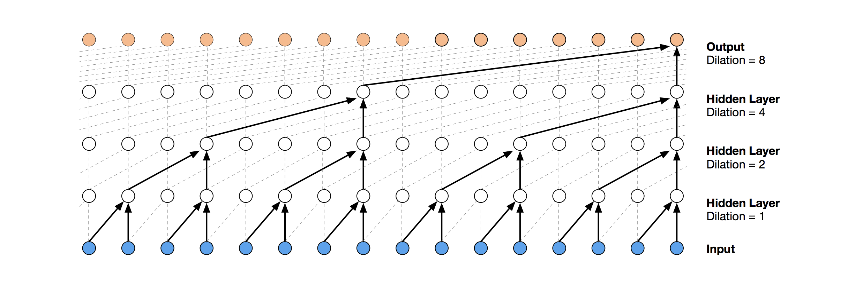

Slide 3
Sine – it maps an angle to a number between -1 and 1

Slide 4


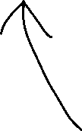
Input vector size
AKA number of features
x.shape
(500, 200, 2)
Number of sequences
Number of time steps in each sequence

Slide 5
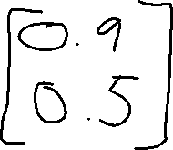
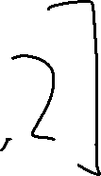
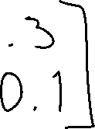










# regression, single output value per time step
TCN(return_sequences=True)
# activation in last layer: problem-specific (e.g. relu)
# loss function: problem-specific (e.g. mean squared error)

Slide 6

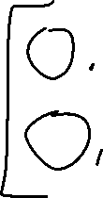
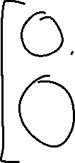
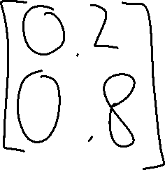

# regression, multiple output values per time step
TCN(return_sequences=True)
# activation in last layer: problem-specific (e.g. relu)
# loss function: problem-specific (e.g. mean squared error)

Slide 7
# regression, single output value per sequence
TCN(return_sequences=False)
# activation in last layer: problem-specific (e.g. relu)
# loss function: problem-specific (e.g. mean squared error)

Slide 8
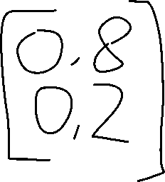
# regression, multiple output values per sequence
TCN(return_sequences=False)
# activation in last layer: problem-specific (e.g. relu)
# loss function: problem-specific (e.g. mean squared error)

Slide 9



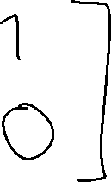

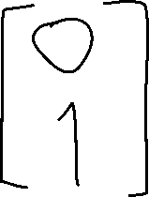
# classification, two classes, predict per time step
TCN(return_sequences=True)
# activation in last layer: softmax
# loss function: categorical_crossentropy

Slide 10
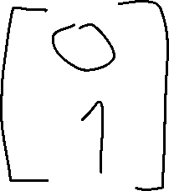
# classification, two classes, predict per sequence
TCN(return_sequences=False)
# activation in last layer: softmax
# loss function: categorical_crossentropy

Slide 11
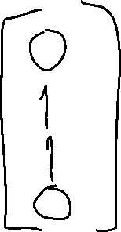
# multilabel classification, four classes, predict per sequence
TCN(return_sequences=False)
# activation in last layer: sigmoid
# loss function: binary_crossentropy

Slide 12
https://github.com/iver56/tcn-example/

